Slide 1
2019 RIF Development Plans
Peter Hambly

Slide 2
Key Objectives for 2019
RIF Priorities for the first quarter of 2019 are:
Make the RIF Usable within SAHSU
Risk analysis specific graphs
Multiple (used in statistical calculations) and additional (for use outside of the RIF) covariate support;
Pooled or individual analysis for multiple risk analysis points/shapes (e.g. COMARE coordinates);
Oracle interconnect support (RIF access to remote numerator data in Oracle)
Improve the installation process

Slide 3
Spring 2019 on:
Full multiple covariate support;
Information governance;
Data loading;
Logging and auditing;
Data extract improvements;
Cluster analysis;
R scalability.
This is likely to change to adapt to funder requirements.

Slide 4
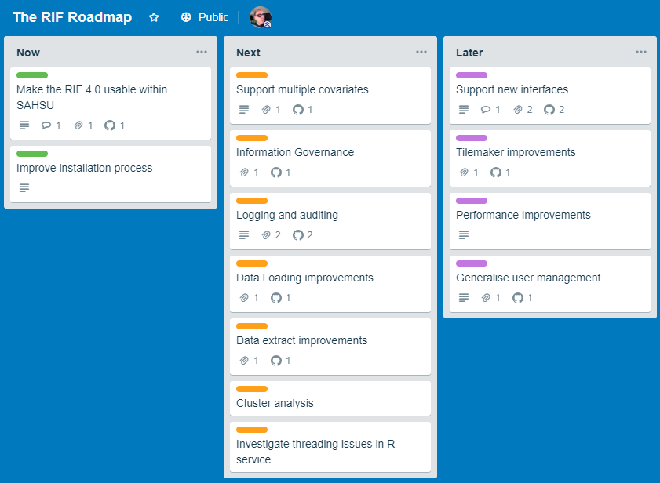
Roadmap: https://trello.com/b/CTTtyxJR/the-rif-roadmap

Slide 5
Information Governance
Add new users;
Manage table/viewspermissions (grant SELECT on table/view to role);
Add new roles, manage what users have what role;
Display per user view of privileges;
Ability to submit but not run a study; running requires approval;
Per user/role low cell counts restrictions;
Per user/role resolution restrictions;
Create restricted views of tables.

Slide 6
Data Loading
This will be a "Data Loading" tab with four new icons similar to the trees:
Geographies;
Denominator data;
Covariates;
Numerator data;
It would be able to:
Convert age and sex to AGE_SEX_GROUP;
Add additional required geography fields to data;
Verify the defined primary key;
Partition and index the data

Slide 7
Statistical Improvements
Multiple covariate support;
Cluster analysis: implement SatScan and BaySTDetect
SatScan – using the kulldorff function in the R package SpatialEpi;
BaySTDetect – will need to be ported to R from WinBugs
R scalability: support for multiple R threads, remote R webservice pool. This will allow the RIF to run multiple studies at the same time and to scale to large multi user environments;
Support for Islands in adjacency matrices (select the nearest mainland area);
Ability to set priors.

